Slide 1
Register. Learn. Commit. Vote.
Notes:
SLIDE 1
1. Introduce the presentation team. Give a brief description of the League of Women Voters – an all volunteer, nonpartisan group of women and men striving to make democracy work by encouraging people to be informed citizens and participants in our democracy. The group was formed during the Suffrage Movement as women sought the right to vote. The Texas Chapter of the League of Women Voters turns 100 years old in 2020!!
2. The entities responsible for the First Vote program are the Travis County Tax Office Voter Registration Division, the Travis County Clerk Elections Division, and the League of Women Voters Austin Area. This is the third year the League has been bringing this program into Austin Area high schools.
3. The purpose of this presentation is to make sure you know how important it is to stay engaged in the democratic process and stay informed about the issues important to you, make your voice heard through voting, register to vote and commit to vote in the next and EVERY election.

Slide 2
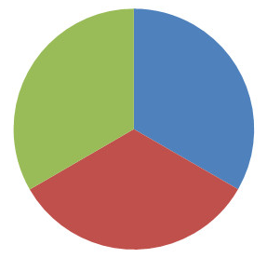
Your Vote is Your Voice!
Everyone Stand up – You are the eligible voters ages 18-24!
One third of the room – Sit down, You didn’t Register to Vote!
Half of those standing – Sit down, You Registered, but didn’t Vote!
Are you willing to let one-third of your classmates make decisions for you?
Tufts University estimates that 31% of eligible young people voted in the 2018 midterm elections, a dramatic increase over the youth turnout in 2014 and the highest level of youth participating in a midterm cycle in at least the last 25 years.
Notes:
SLIDE 2
Everyone! Stand up! You represent the number of young people, ages 18-24 who are eligible to register to vote in the U.S.
One third of you! Sit down! Those sitting represent the roughly 1/3 of young people who did not even register to vote. So you CAN’T vote.
Half of you standing! Sit down! Those sitting represented people who are registered, but don’t go vote.
The few people who are still standing, you represent the number of young people, ages 18-24, who actually DO GO VOTE. These are the people making the decisions for the rest of you. They are the ONLY ones in your age group having a say in YOUR government and what it does. Are you willing to let 1/3 of your classmates make decisions for YOU?

Slide 3
Help Determine Who Gets Power
Notes:
SLIDE 15
Janelle Monae makes a convincing point about how voters determine who gets in positions of power. This is a public service announcement from WhenWeAllVote.com. You can find it on YouTube!
[Share your personal experience about voting and if there’s time, walk them through the process:]
You’ll be asked to show your I.D. – and if you don’t have one of the forms of I.D. required, you’ll sign a document called an affidavit swearing that you were unable to obtain the I.D.
You’ll move down the line and be asked to sign on a form verifying your address.
You’ll verify that the precinct shown on a print-out matches the precinct you live in.
You’ll receive a receipt with a four-digit passcode on it, which you’ll take into the voting booth with you.
Enter the four-digit passcode into the machine and then follow the instructions on each screen. Travis County has new machines this year, and we haven’t seen them yet, so we can’t tell you exactly what they’ll look like.
If you have any questions at any time—call over an election worker BEFORE YOU CAST YOUR BALLOT! Once you press the button to cast your ballot, you cannot change anything!

Slide 4
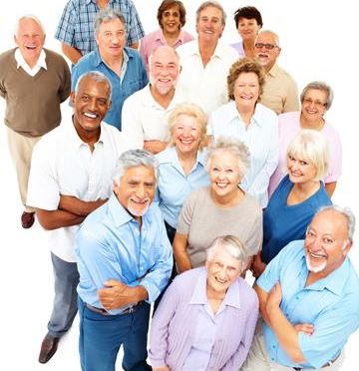
Those who show up get their way!
70% of those over 75 voted in 2016
49% of 18-38 year-olds voted in 2016
Notes:
SLIDE 4
If we want to influence what happens in our community, we have to show up at the polls and vote. We want our government to pay attention to us, and to reflect the will of ALL people. Certainly, not everyone in a given demographic group votes the same way, but different demographic groups will prioritize different issues simply based on where they are in life. Young people are more likely to be concerned about things like college debt and the environment; while older people may focus on Medicare and the retirement age. If only certain groups show up to vote, that is not good representative government.
During the presidential election of 2016, 70% of those over 75 years old reported voting, but only 49% of 18-39 year-olds reported voting in 2016.
So it was the the older generations that mostly influenced the outcome of the election in 2016.

Slide 5
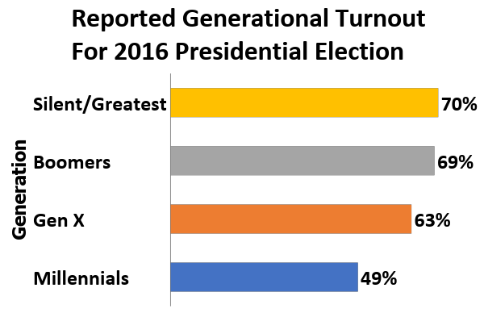
75 yrs >
54-74 yrs
39-53 yrs
18-38 yrs
Fry, May 2016
Notes:
SLIDE 5
Let’s look at what happened in the last Presidential Election. In 2016 70% of the Silent/Greatest generation reported voting and 69% of the Boomers reported voting. So these two generations – people older than 54 – your parents and grandparents -- had a great influence on the outcome at the ballot box. Notice that 49% of people in your generation (Gen Z and the Millennials) reported voting.

Slide 6
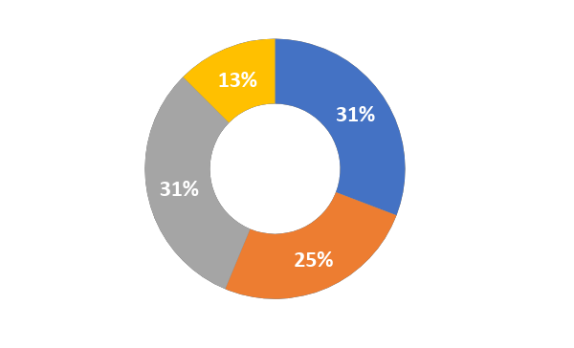
Representation of Voting Population in 2016
Silent/Greatest
Generation
75 yrs +
Gen Z / Millennials
18-38 yrs
Baby
Boomers
54-74 yrs
Gen X
39-53 yrs
Notes:
SLIDE 6
This slide illustrates the potential voting power of each of the generations based on 2016 stats.
Look at your generation! You have power! You make up almost 31% of the eligible voters. Your generation exceeds the power of your parents’ generation, Gen X. And your generation is catching up to your grandparent’s generation -- the “Baby Boomers.”
Remember the last slide? (Flip back and forth between slides, if you want) 70% of the silent/greatest generation reported voting. And look – they make up just 12.5% of the total electorate. 49% of the Gen Z/ Millennial generation voted and they make up 30.8% of the electorate.
Imagine how different the outcome would be if 70% of your generation turned out to vote! In fact, if 70% of each generation would vote, we would approach a truly representative government.
http://www.pewresearch.org/fact-tank/2018/04/03/millennials-approach-baby-boomers-as-largest-generation-in-u-s-electorate/

Slide 7
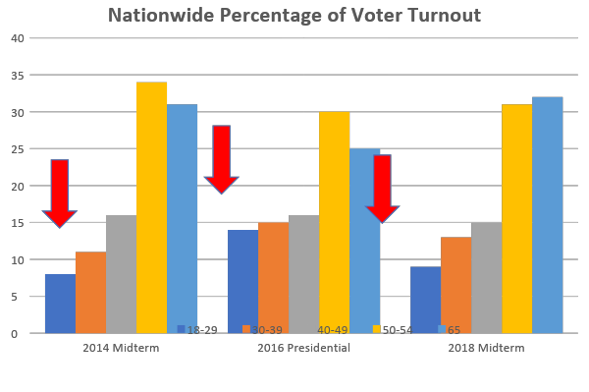
Age Range Comparisons 2014-2018
United States Elections Project
www.electproject.org
Notes:
SLIDE 7
Let’s look at some voting stats from the last three national elections. Here is a set of three bar graphs. The first one shows the voting percentages in the 2014 MIDTERM election for 5 age ranges.
Notice that your age range made up about 8% of the voters. It looks like people over 50 had the greatest turnout.
Look at the second bar graph. The second one shows the same age range voting percentages in the 2016 PRESIDENTIAL election. In presidential election years, there is always a greater turnout than in the midterms. This has been the norm since we started keeping track of voter turnout in 1914. During this national election, your age range increased turnout! Your age range made up 14% of the total turnout.
Look at the third bar graph. Now this is another MIDTERM, but notice that people in your age range showed up in greater numbers than the prior midterm. Your turnout was 9% of the total turnout.
So your turnout is trending upward, and we hope you’ll help to continue that trend! Texas voting statistics track exactly with national statistics, with young people making up 8% of the Texas vote in 2014, 14% of the Texas vote in 2016 and 9% of the Texas vote in 2018.

Slide 8
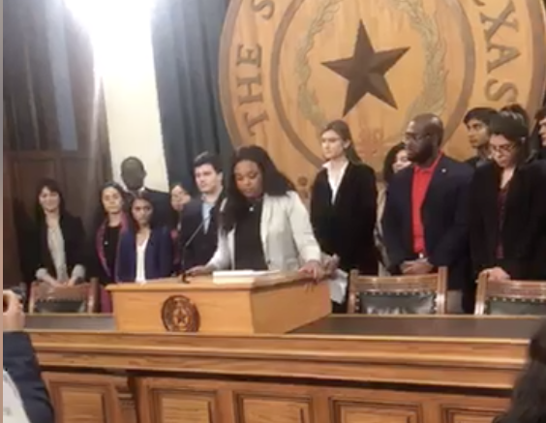
Young People Making Their Voices Heard
HB 375 requires counties to establish a polling location on the main campus of an institution of higher education in Texas if it has more than 9,000 students.
The bill was filed this year by State Rep. Gina Hinojosa after UT students lobbied her on behalf of the measure.
Notes:
SLIDE 8
Just to show you that young people are stepping it up—here’s a great example. Students at the University of Texas were successful in petitioning Travis County to open an additional polling location on the UT campus during the 2018 election. So they worked to write Bill 375 which, if it becomes law, would require counties to establish a polling location on the main campuses of colleges and universities with more than 9000 students.
This bill was filed in the Texas Legislature this February. If it becomes law, college students will have easier access to vote, and it will increase the voting power of their generation. Do you think voters over 50 years old would have realized that it’s really hard for young people—who often don’t have cars and aren’t necessarily familiar with their college city’s polling locations—to get to the polls?
This is a great illustration not only of youth activism, but how important it is that people in ALL age groups speak up about the things that matter to them, and VOTE.

Slide 9
What is important to YOU?
HEALTHCARE
ENVIRONMENT
COLLEGE TUITION
MINIMUM WAGE
IMMIGRATION
GUN RIGHTS
Notes:
SLIDE 9- skip activity???
[Before the First Vote session begins, the presenter will place the 6 issue cards around the room.]
Having easy access to a polling location is important to the UT students who initiated Texas HB 375.
What issues are important to you? Here are some current topics of interest -- You will see cards with these issues posted around the room. Of these 6 topics, which is of greatest concern to you? Please go stand by the issue that is something you care about and would like your elected officials to address.
[Everyone will walk to the issue that is his or her #1 concern. Once everyone has moved, engage individuals depending on how the group has responded. Maybe there is one issue that most of the kids gravitated toward, or maybe everyone is evenly spread out. If many people are on one issue, ask someone to tell you why he/she chose that. Ask other students what are some possible solutions to address they issue. Move around the room to other issues that the students have chosen and ask the same.]

Slide 10
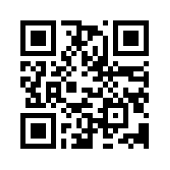
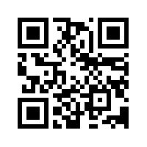
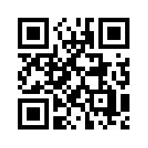
How Do You Align with Political Parties and Your Elected Officials?
isidewith.com/political-quiz
people-press.org/quiz/political-typology
myreps.datamade.us
Notes:
You should understand how your beliefs most closely align with the major political parties so you’ll have an idea of how you’d like to vote. There is a great website called ISideWith that can help you determine for yourself which political party your beliefs most closely align with (www.isidewith.com/political-quiz). The Pew Research Center also has a great site to help you determine your political typology based on how you feel about different issues. You might want to check it out: www.people-press.org/quiz/political-typology/
Once you know how YOU feel about the issues of most concern to you, you can find out how your elected officials and candidates asking for your vote stand on these issues. Visit their websites! If you need help finding who represents you, go to http://myreps.datamade.us/. [If there is time, you can demonstrate how to find elected officials.]

Slide 11
You can register to vote if you:
Are a U.S. citizen
Are 17 years 10 months or older
Have not been declared mentally incompetent by a judge
If you have been convicted of a felony, you must have completed punishment (off-paper)
Notes:
SLIDE 10
One of the main reasons why we are here today is to register people to vote! Here are the requirements:
[Read through the bullets]
Regarding the last bullet, Travis County says:
You are not a convicted felon, or, if convicted you have been pardoned or fully discharged your sentence, including any term of incarceration, parole, supervision, or probation

Slide 12
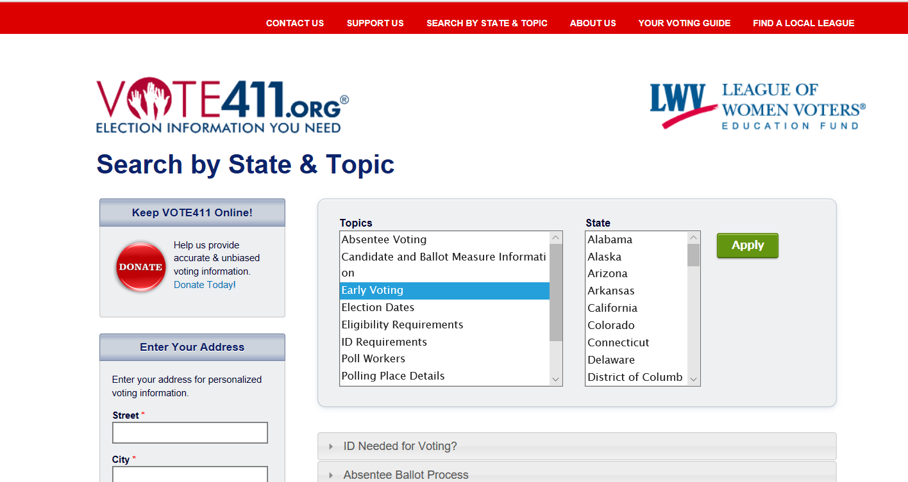
Learn About the Issues
Get Unbiased Information
Notes:
SLIDE 11
Once you are registered, then it is time to learn about who is running, and find out how they stand on the issues! We recommend the website VOTE411.org. The League of Women Voters provides this resource online and in paper format, called the Voters Guide. The League is non-partisan, which means it neither supports nor opposes any particular candidate or political party. We do, however, take positions on issues after careful study, discussion, and consensus.
The Voters Guide is published by the first day of early voting and is as unbiased as possible. All candidates are asked the same questions and their answers are published exactly how they submitted them. We get Pros and Cons from organizations knowledgeable on the issues and publish both sides. If we have an opinion on a ballot issue, we never publish it in the Voters Guide. You can get the Voters Guide in public libraries [Show a copy if you have one]. Digital PDF versions are available on our website. And now you can get it personalized with the candidates and ballot initiatives on your specific ballot by entering your address on Vote411.org.
An important thing to remember is that you cannot bring electronic devices into the voting booth with you--but you can bring a hardcopy list of the candidates you have decided you are voting for.

Slide 13
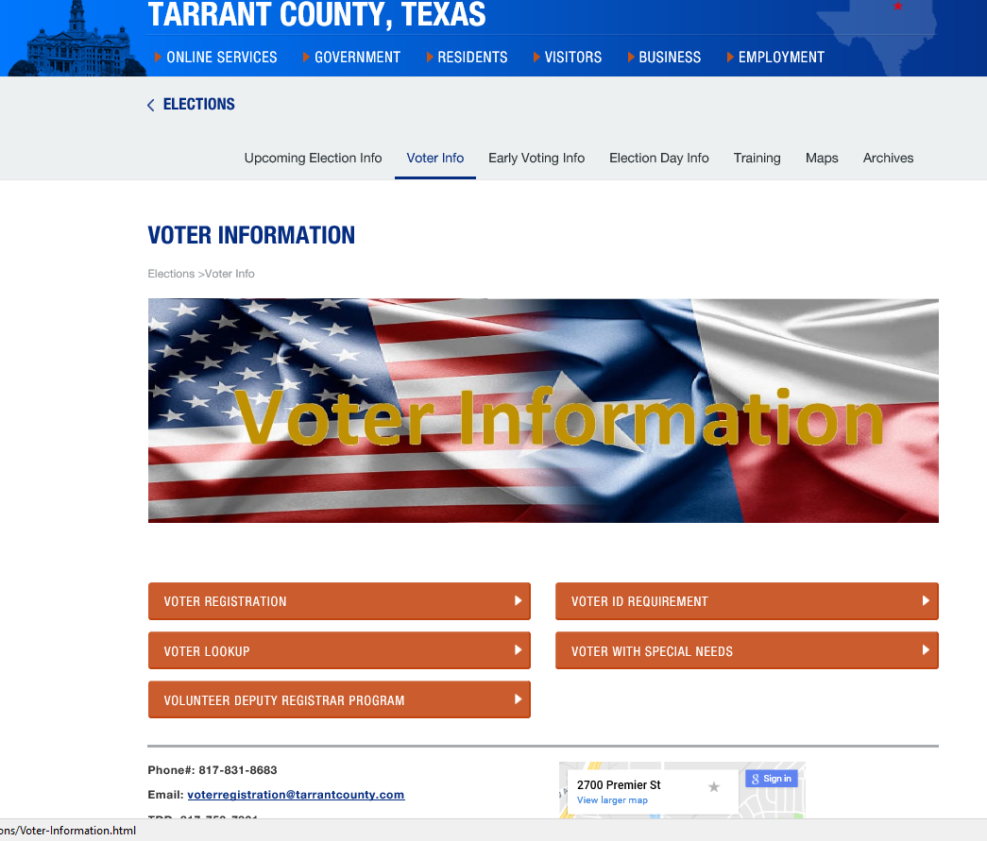
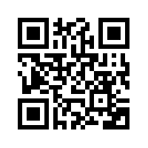
Polling Locations
Sample Ballots
Early and Absentee voting
Voter ID Requirements
General Voter Information
Voter Lookup to
Confirm Registration
Election Results
Notes:
SLIDE 13
Before every election, visit this site to find the polling location nearest you—you can even compare waiting times at different polling stations. You can see a sample ballot so you know what you’re going to be considering in the voting booth, be reminded about what voter ID to bring to the polls, and more. And if you have any concerns about whether you’re registered to vote, you can come here, put in your address, and confirm that you are, indeed, registered.

Slide 14
I.D. Required for Voting in Texas
Texas Driver license (DPS)
Texas Election I.D. Certificate (DPS)
Texas Personal I.D. (DPS)
Texas license to carry a handgun (DPS)
U.S. military I.D. with photo
U.S. citizenship certificate with photo
U.S. Passport
If you can’t get one of these, you can fill out a reasonable impediment exception
Visit SpreadtheVote.org to get help with I.D.
Notes:
There is a new organization called Spread the Vote, who will actually help you apply for the right I.D., and will even drive you to the correct office to obtain it. If you do not have one of the I.D.s listed here, I urge you to contact SpreadtheVote.org as soon as possible to get the I.D. you need.
With the exception of the U.S. Citizenship Certificate, which does not expire, for voters aged 18-69, the acceptable form of photo identification may be expired no more than four years before being presented for voter qualification at the polling place. For voters aged 70 or older, the acceptable form of photo identification may be expired for any length of time if the identification is otherwise valid.
Here is a list of the supporting forms of ID that can be presented if the voter does not possess one of the forms of acceptable photo ID and cannot reasonably obtain one:
copy or original of a government document that shows the voter’s name and an address, including the voter’s voter registration certificate;
copy of or original current utility bill;
copy of or original bank statement;
copy of or original government check;
copy of or original paycheck; or
copy of or original of (a) a certified domestic (from a U.S. state or territory) birth certificate or (b) a document confirming birth admissible in a court of law which establishes the voter’s identity (which may include a foreign birth document).
After presenting one of the forms of supporting ID listed above, the voter must execute a Reasonable Impediment Declaration.
VoteTexas.Gov has FAQs and additional information.

Slide 15
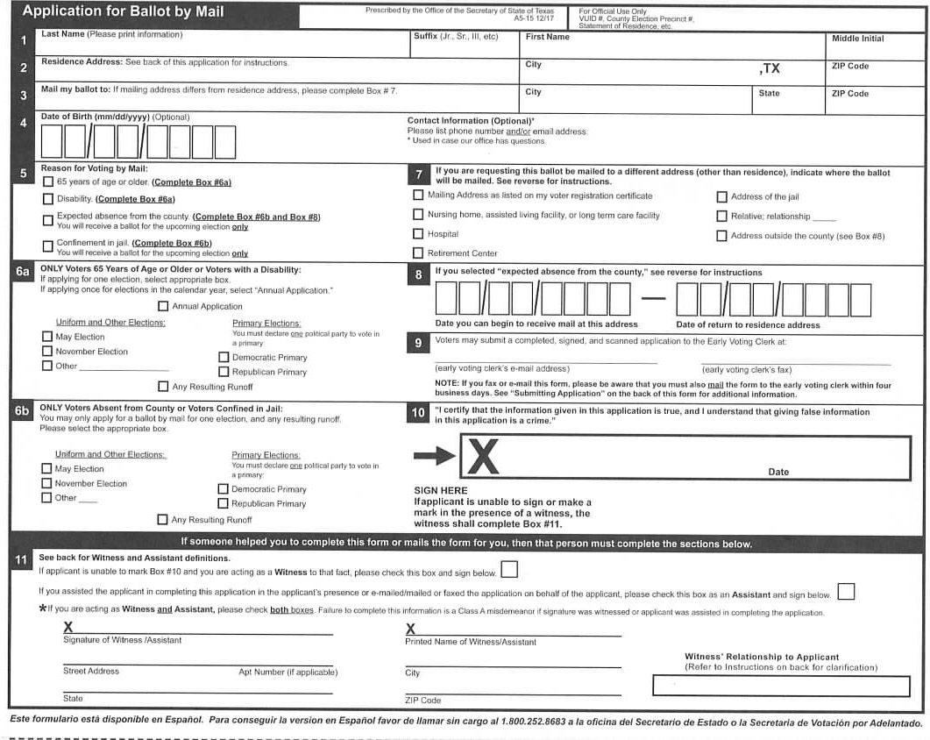
VOTING BY MAIL/ABSENTEE BALLOT
If you will be out of the county during early voting and on election day:
Apply for an Absentee Ballot at least a month before the election: Vote.org/absentee-ballot/Texas
Ballot will come in the mail--follow instructions carefully—there are several places to sign. Always sign the same way, as it appears on your I.D.
Mail back to your County’s Voting Clerk (Find at: Vote411.org)
Make sure it will arrive by the day following the election
Notes:
SLIDE 16
BALLOT BY MAIL: If you are going to be living in another city on any election date and during early voting – for military service, college, a job or travel – You can choose to register in that new place, or if it is temporary, you can use your parents’ address as your own and apply for an absentee ballot.
You will find a way to print and submit the application for a ballot by mail on the Travis County or Williamson County Elections website. Mail your ballot to the correct Voting Clerk.
When the ballot arrives, read it thoroughly, do your research at Vote411.org, make your selections, and SIGN everywhere it asks for a signature. Use the same signature that appears on your I.D.,
Be sure to send in your absentee ballot by the deadline! Look up the correct Voting Clerk address for your county at Vote411.org.

Slide 16
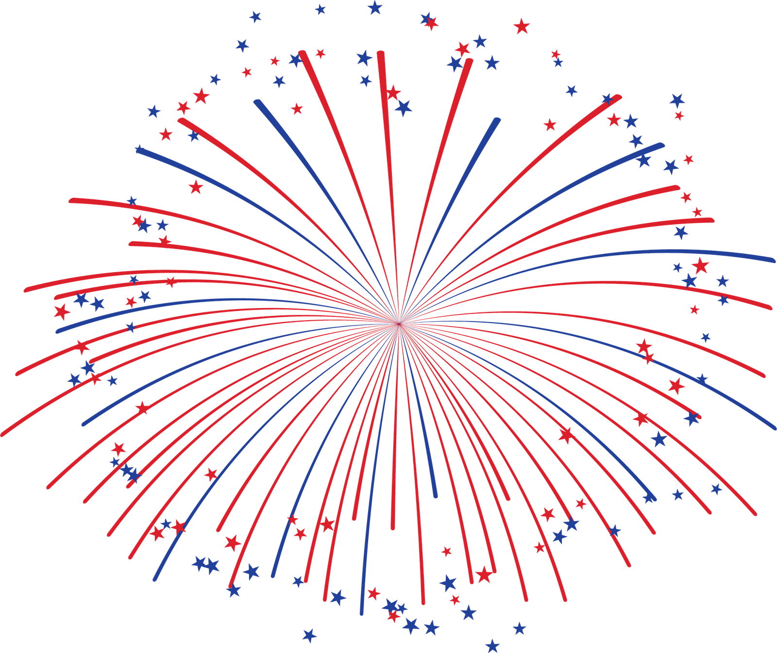
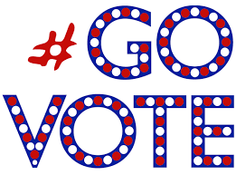
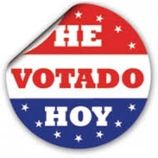
Be A Voter!
DON’T WEAR CLOTHING OR HATS WITH POLITICAL MESSAGES TO THE POLLS!
Notes:
SLIDE 14
BE A VOTER! It is important to BE A VOTER and participate in our democracy! Not just once, but consistently—every year, every election, local, state and national. Those who make a plan to vote are most likely to follow through! Make use of the VoteTravis.com website I just showed you.
[Pass out Vote411.org folding cards to show the timeline for this year’s elections.]
Are you going to vote early or wait for election day? Will your school or work schedule keep you from voting? Polls are open from 7am to 7pm, and you can vote at any polling station--where are you going to vote, and how are you going to get there? Do you need to ask someone for a ride? Do you know what identification you need to bring with you? (Check VoteTravis.com!)
Plan on how you are going to celebrate after you vote. Make it a group event—vote with your family or friends then go out afterward, make an event out of it!
REMEMBER: You cannot wear political t-shirts or hats into the polls.

Slide 17
Other Resources
Libraries always help!
https://www.whenweallvote.org/
https://www.votetexas.gov/
https://my.lwv.org/texas
https://www.tarrantcounty.com/en/elections.html
https://www.rockthevote.org/

